Slide 1

Minimizing MLB Team Travel
Using Optimization
Ari Kolahal • Aryan Sehgal • Barrett Ratzlaff • Jerry Lin

Slide 2


Problem Statement
Why does this matter?
Our Goal
Injury & Fatigue: Excessive travel significantly increases fatigue and injury probability for athletes.
To minimize total travel distance for the AL East division while strictly satisfying all MLB scheduling rules.
Complex Logistics: Even for one division, assigning home / away slots is a large combinatorial optimization problem
By using integer programming, we aim to prove that smarter routing can save thousands of miles per season.

Slide 3
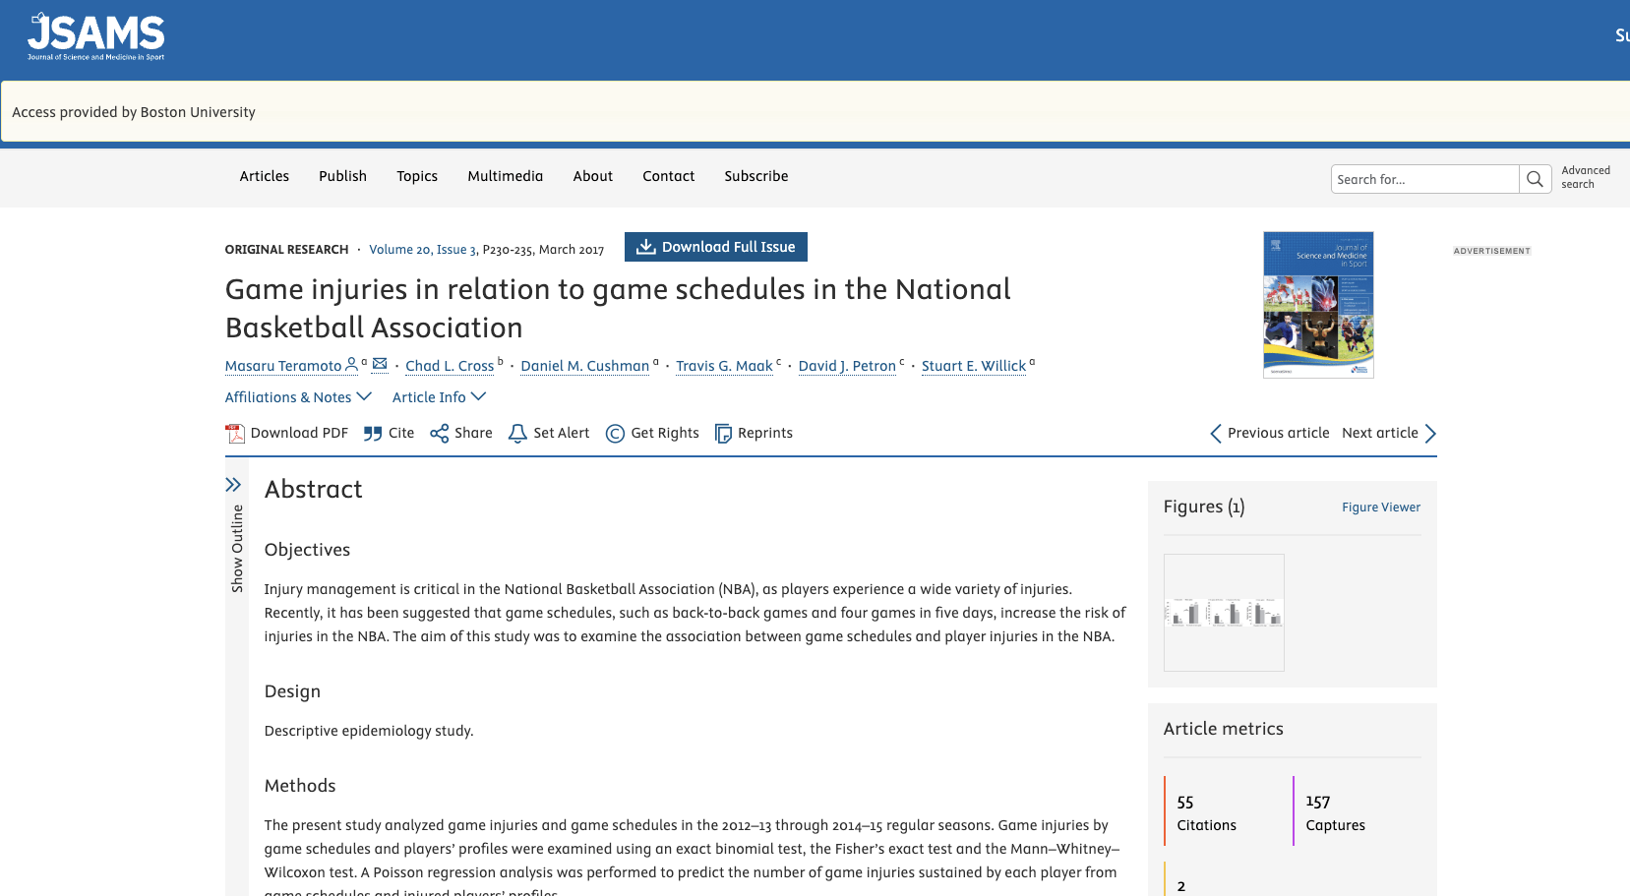

Slide 4




Stakeholders and Impact
Athletes
League Officials
Travel has a measurable impact on fatigue and injury risk. A schedule that minimizes distance directly improves player performance and protects long-term health.
Healthy rosters keep star players on the field, which stabilizes revenue from attendance, broadcasting, and sponsorships. Lower travel also creates a more competitively fair season.

Slide 5




Model Implementation
Python Setup
Gurobi Solver
Output Generation
Constructed the pairwise distance matrix using geopy and airportsdata packages.
Defined decision variables (matchups and location) and implemented all constraints.
Solved for the global optimum and exported the results into schedule_df and travel_df for analysis.

Slide 6





Background & Data
Scope & Data
Tools & Rules
Optimization: Gurobi Solver.
Scope: AL East Division at first (5 Teams: BOS, NYY, BAL, TB, TOR), then expand to all American League (15 teams).
Calculations: Python geopy for geodesic distance and airportsdata for coordinates.
Time Horizon: One-month optimized scheduling window.
Constraints: Adherence to MLB divisional scheduling rules (series length, frequency).
Data Source: Airport-based Pairwise Distance Matrix between stadiums.

Slide 7
Optimization Model: Overview
Objective
Decision Variables
1. x ᵢⱼₛ ∈ {0,1}
Equals 1 if Team i travels to Team j in Slot s, 0 otherwise.
Minimize the total cumulative travel distance for all teams over the scheduling horizon.
2. loc ᵢₛₖ ∈ {0,1}
Equals 1 if Team i stays at team k’s stadium in Slots s, 0 otherwise.
We utilize a Slot-Based approach where each "slot" represents a 3-game series to simplify the calendar.
3. travel ᵢₛₖ₁ₖ₂ ∈ {0,1}
If team i stays in stadium k1 at slot s and stadium k2 at slot s+1, then travelᵢₛₖ₁ₖ₂ = 1.
This helps link consecutive slots to calculate travel distance between Series A and B.

Slide 8
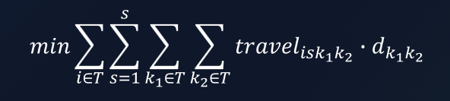
Objective Function
We minimize the sum of all travel distances:

Slide 9
Key Constraints
One Series Per Slot: Each team plays exactly one opponent per time slot.
Divisional Requirement: Each pair of teams must meet a minimum number of times.
No Back-to-Back Series: Teams cannot play the same opponent in consecutive slots to ensure variety.
No Self-Games: A team cannot play against itself (xᵢᵢₛ = 0)
Minimum Total Series: Each team must play at least the required number of series within the month
Location Tracking: The model must track the physical location of each team at the end of slot s to calculate travel to slot s+1.
Minimum Home/Away Series: Each teams must meet a minimum number of home/away series.
Binary Integrity: All decision variables are strictly binary (0 or 1).

Slide 10
Results: Optimized Schedule
Sample output for the first two team, showing efficient pairing:
Team | Opponent | Home/Away | Slot
Athletics | Los Angeles Angels | Away | 0
Athletics | Seattle Mariners | Home | 1
Athletics | Minnesota Twins | Home | 2
Athletics | Los Angeles Angels | Home | 4
Athletics | Seattle Mariners | Away | 6
Athletics | Minnesota Twins | Away | 7
Baltimore Orioles | Toronto Blue Jays | Home | 0

Slide 11
Results: Route and Distance
Sample output for the route and distance for the first team
Team | Slot | From | To | Distance (miles)
Athletics | 0 | Los Angeles Angels | Athletics | 387.19
Athletics | 1 | Athletics | Athletics | 0
Athletics | 2 | Athletics | Athletics | 0
Athletics | 3 | Athletics | Athletics | 0
Athletics | 4 | Athletics | Athletics | 0
Athletics | 5 | Athletics | Seattle Mariners | 605.42
Athletics | 6 | Seattle Mariners | Minnesota Twins | 1398.91

Slide 12



Results: Total Travel Distance (Five Teams, One Month)
~8,000
3,874
MILES (BASELINE)
MILES
Naive Scheduling
Fixed Tracking
By building our first few optimization models, we achieved a massive reduction in unnecessary cross-country travel.

Slide 13
















Sensitivity Analysis
Scaling Number of Teams
Limit on Consecutive Home/Away Series
Home/Away Requirements
Scenario: Expanded the model from 5 teams to 15 while keeping the core constraints
Scenario: Imposed a cap of at most 3 consecutive home or away series for any team
Scenario: Require every team to play at least 3 home and 2 away series out of the 8 slots
Result: Total travel naturally grew but optimizer performed well by producing schedules where teams moved within geographic clusters
Result: Schedule is more realistic but total travel distance increased as teams have to alternate between home and away more often
Result: Drastic increase in travel since solver now had less flexibility to form geographically efficient sequence of series

Slide 14
Results: Total Travel Distance (15 Teams, One Month)
87,000
25,832
V.S.
MILES (REAL WORLD)
MILES (MODEL SOLUTION)
Estimate
Adjusted Constraints

Slide 15
Interpretations & Insights
Model vs Real-World Schedule
The Efficiency Tradeoff
Our model uses 15 teams, series-level slots, and simplified constraints, while MLB schedules 30 teams across individual games with many operational factors (TV, venue availability, rest days).
Real teams travel roughly 5,800 miles totally per month; our optimized schedule required only 1,700 miles per team per month, showing the reduction possible when minimizing travel is the sole objective.
There is a clear tradeoff between Fairness/Variety and Efficiency. A purely efficient schedule is repetitive and unfair; a perfectly varied schedule is logistically expensive.

Slide 16
Biggest Challenges
Transition Logic
Realism & Feasibility
Linking each team’s location across consecutive slots was the hardest part of the model.
We had to ensure the solver correctly tracks where a team finishes Slot s to compute the travel required for Slot s+1.
Any mismatch in this linkage produced unrealistic routes or incorrect distances.
Enforcing scheduling rules like one series per slot, no repeated opponents, and valid home/away assignments required careful constraint design.
Debugging home/away logic was essential to prevent impossible outcomes, such as a team appearing in two stadiums simultaneously.
Most modeling errors came from feasibility issues, not the objective function itself.

Slide 17



What We Learned
Practical Value
Real-World Logic
Scalability
Our optimized schedule reduced travel by over 50%, showing how some inefficiency may exists in manual or tradition-based scheduling (not considering external factors)
Even simple optimization frameworks can significantly lower fatigue, injury risk, and operational cost.
Designing the model around series-level slots mirrors how MLB schedules in practice.
Incorporating rules like minimum divisional matchups, balanced home/away sequences, and no back-to-back opponents reinforced the realism of our outputs.
The same model structure extends naturally from 5 to 15 to 30 teams; only computational complexity grows.
This framework generalizes to broader routing contexts such as airline crew planning, delivery logistics, or transportation scheduling.

Slide 18
Thank You!
Questions?

